Slide 1
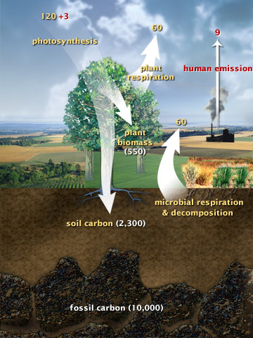
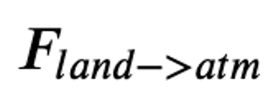
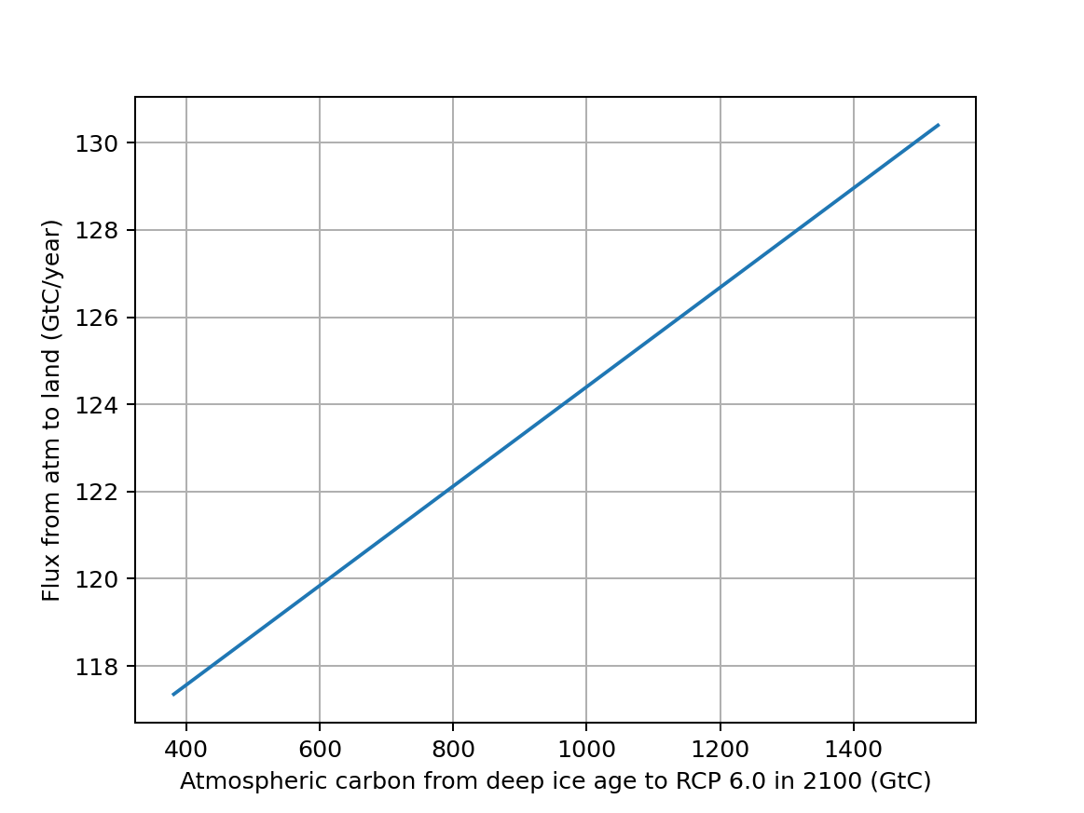
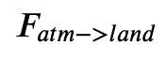
Last week: Atmosphere -> land flux that included CO2 fertilization

Slide 2
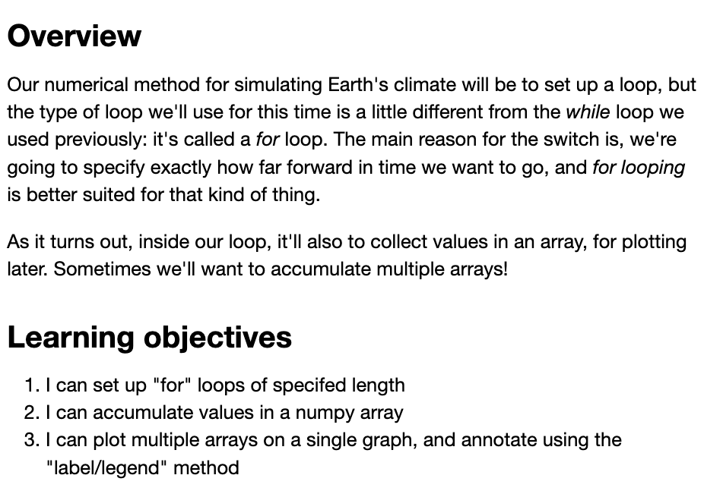
To propagate the effects of these fluxes over time, we’ll need to know about “For Loops”
Week_06a.ForLoops

Slide 3
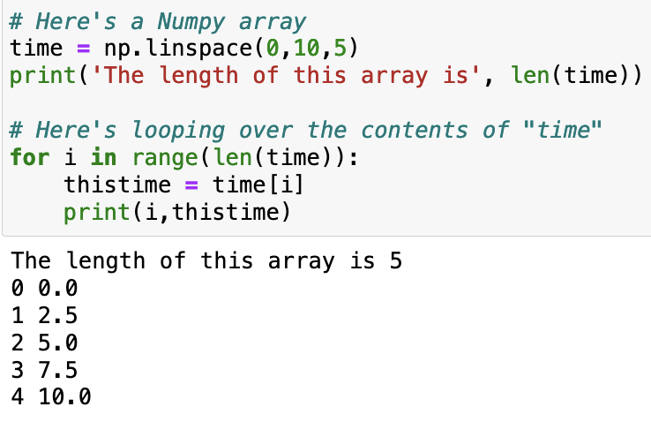
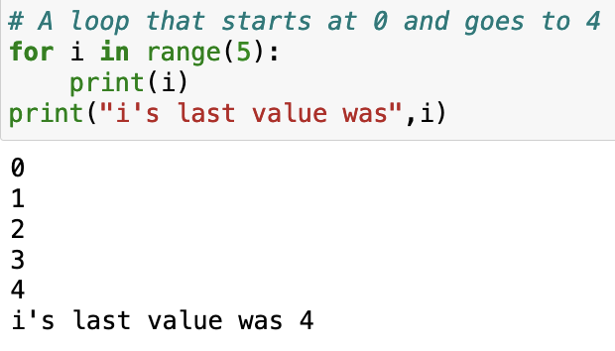
To propagate the effects of these fluxes over time, we’ll need to know about “For Loops”

Slide 4
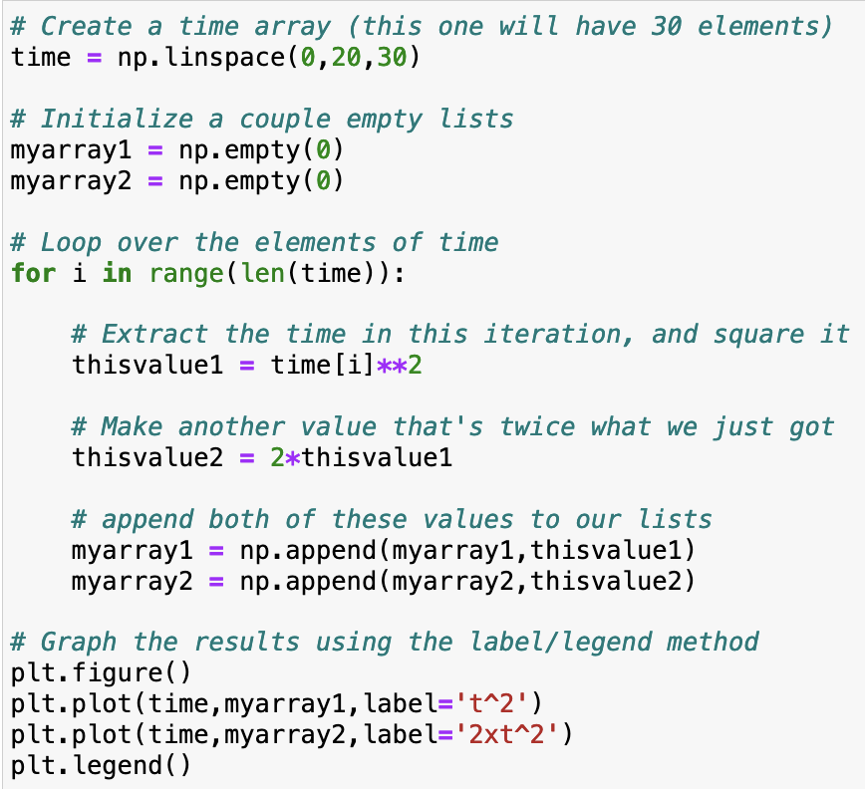
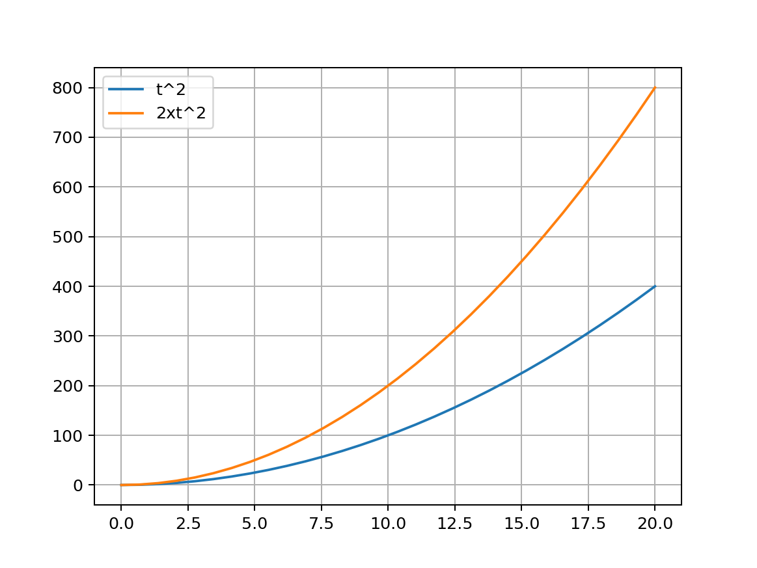
We’ll also need to know how to accumulate the data generated in these loops

Slide 5
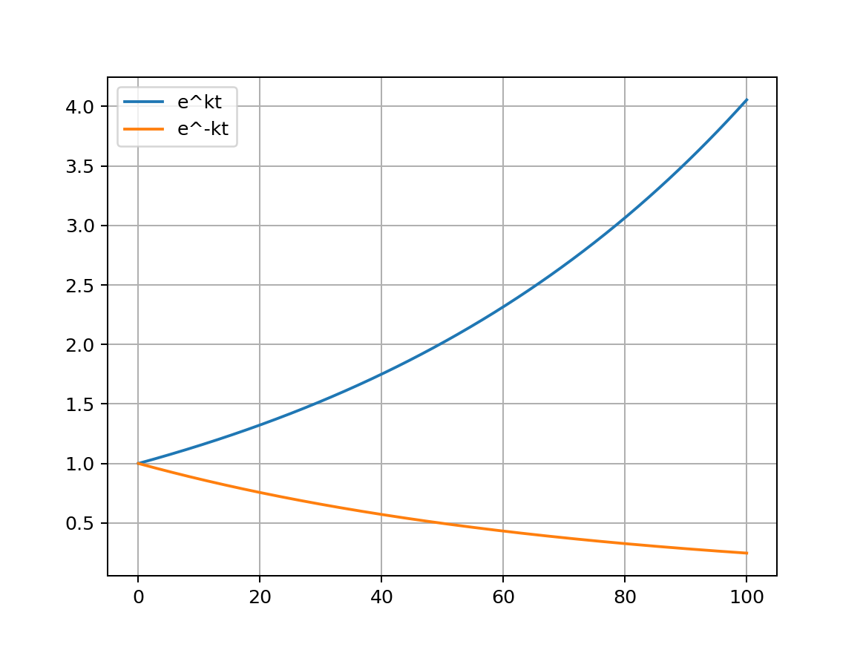
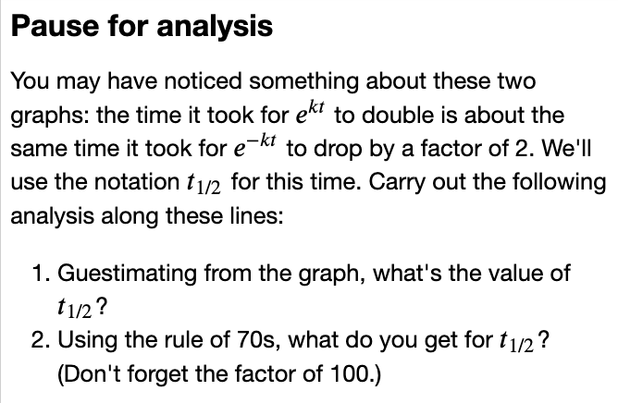

In another loop, you’ll be studying exponential growth and decay
$$k = 0.014$$

Slide 6
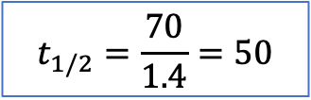
In another loop, you’ll be studying exponential growth and decay
$$k = 0.014$$
$$t_{1/2}=\frac{70}{1.4}=50$$

Slide 7
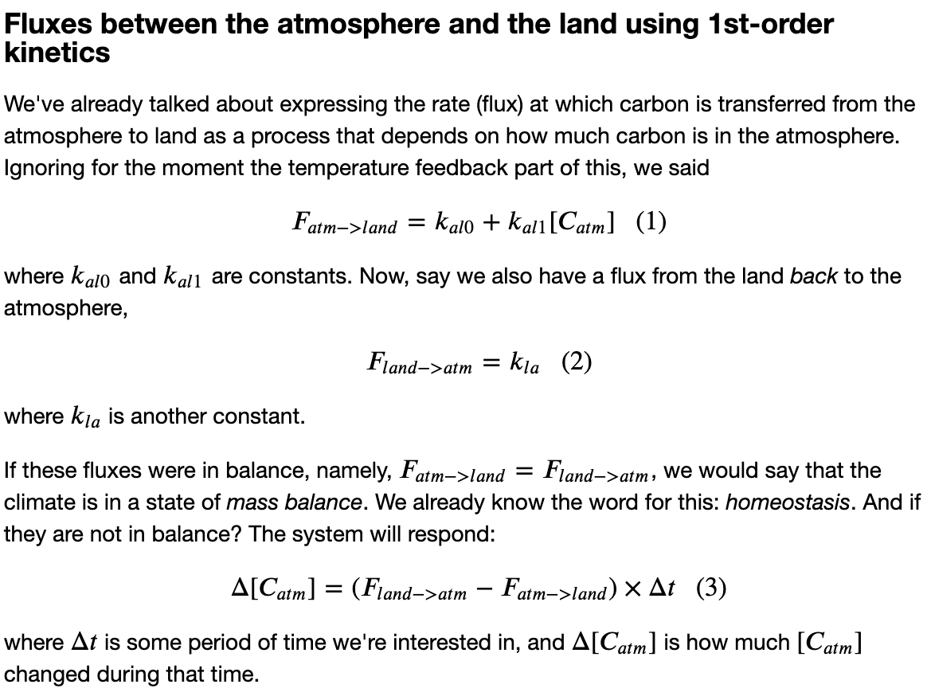
And next? Imagine marching through time, keeping track of carbon fluxes at each time step
Week_06b.Euler

Slide 8
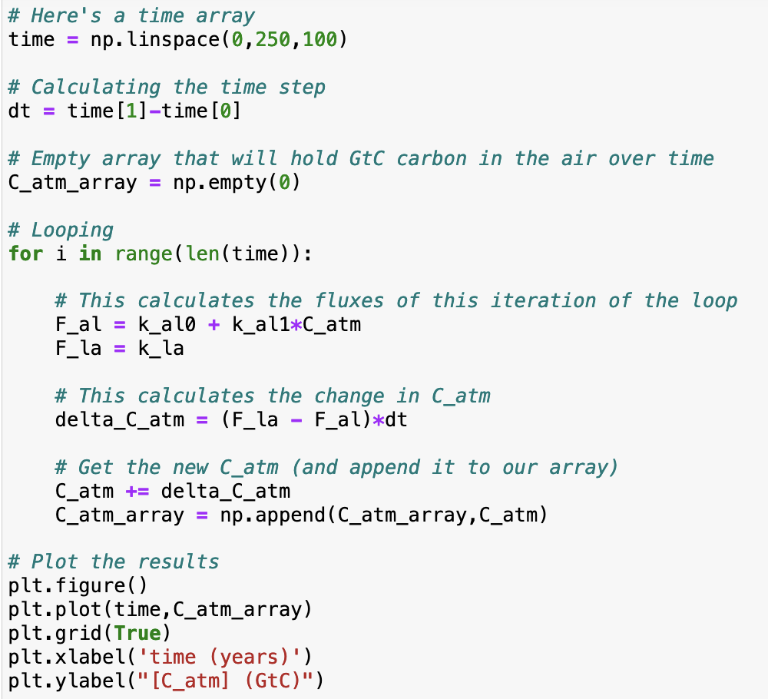
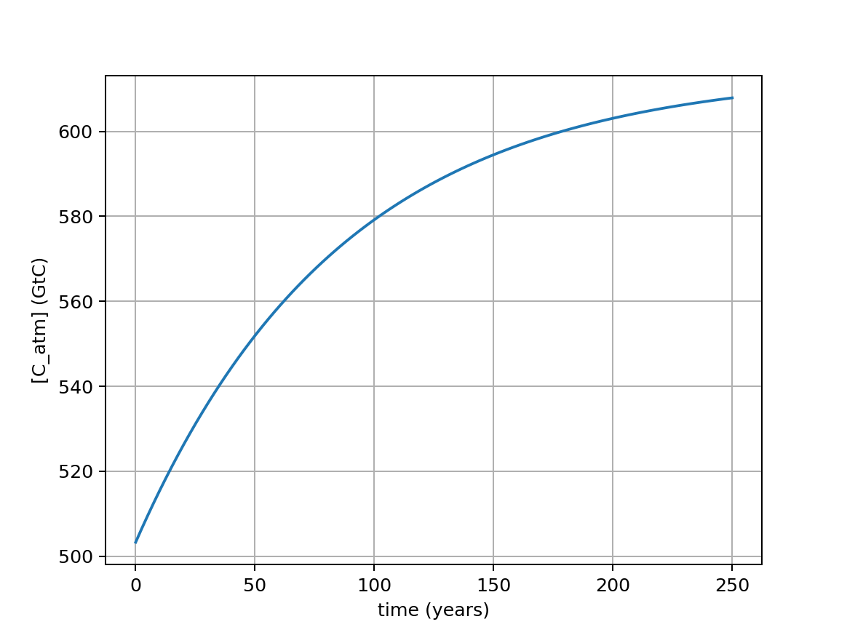
A lot like SimpleRadiativeBalance: proceeding in discrete time steps and saving along the way
Questions …
Will this earth achieve homeostasis?
What’s the time required to get ½-way to homeostasis?

